Slide 1

8th Grade Math: Pre-Algebra
Unit 6, Lesson 4 Exploring Slope Volume 1, pg. 254

Slide 2


Benchmark
MA.8.AR.3.2
Given a table, graph, or written description of a linear relationship, determine the slope.
volume 1, pg. 254

Slide 3
Integrated Mathematical Thinking and Reasoning Standards
MA.K12.MTR.1.1 Actively participate in effortful learning both individually and collectively.
MA.K12.MTR.2.1 Demonstrate understanding by representing problems in multiple ways.
MA.K12.MTR.4.1 Engage in discussions that reflect on the mathematical thinking of self and others.
MA.K12.MTR.5.1 Use patterns and structure to help understand and connect mathematical concepts.
volume 1, pg. 254

Slide 4

Learning Targets
I can define slope.
I can determine the slope given two points.
volume 1, pg. 254

Slide 5

Warm-Up
volume 1, pg. 254

Slide 6
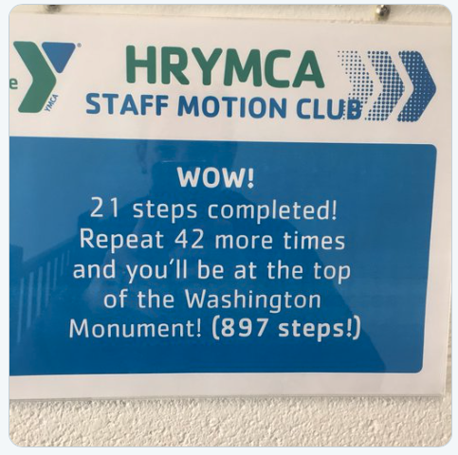
6.4.1 Warm-Up: Convince the Class
Write an explanation to convince the class whether this is a math fail or a reasonable approximation.
volume 1, pg. 254

Slide 7

Exploration
volume 1, pg. 255

Slide 8


6.4.2 Exploration: Exploring Slope Through Ratios
The figure shows three right triangles, each with its hypotenuse on the same line. Each gridline is equal to one unit.
The hypotenuse is the longest side of a right triangle; the side opposite the right angle.
volume 1, pg. 255

Slide 9
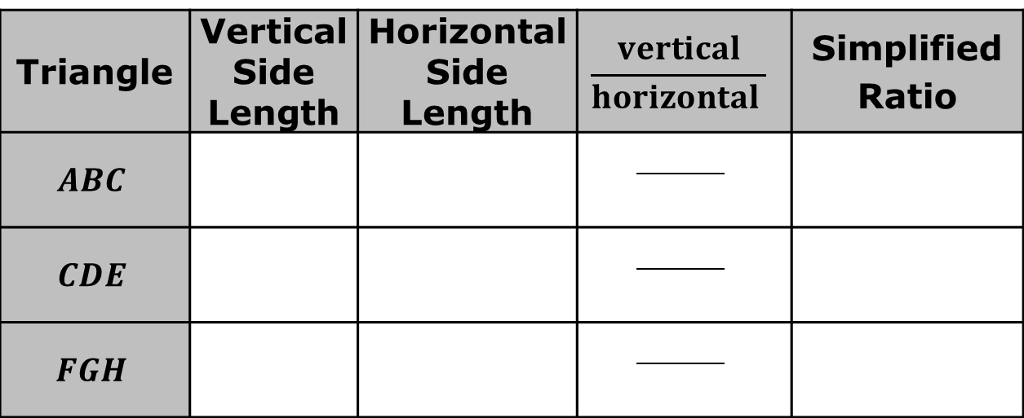
Complete the table.
Triangle | Vertical Side Length | Horizontal Side Length | $$\frac{vertical}{horizontal }$$ | Simplified Ratio
$$ABC$$
$$CDE$$
$$FGH$$
volume 1, pg. 255

Slide 10
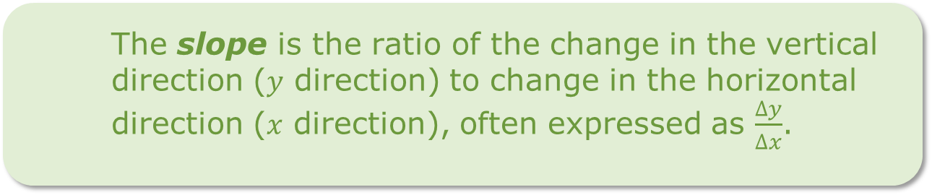
What do you notice about the simplified ratios for the three triangles?
Discuss with your partner and write a conjecture about the ratio of the vertical side length to the horizontal side length of any right triangle with a hypotenuse on the same line as the triangles above.
The ratio of the vertical side length to the horizontal side length of a right triangle is known as the slope of the hypotenuse.
The slope is the ratio of the change in the vertical direction ($y$ direction) to change in the horizontal direction ($x$ direction), often expressed as $\frac{∆y}{∆x}$.
volume 1, pg. 255

Slide 11

Collaboration
volume 1, pg. 256

Slide 12

6.4.3 Collaboration: Constant of Proportionality and Slope
The graph of a relationship is shown.
volume 1, pg. 256

Slide 13
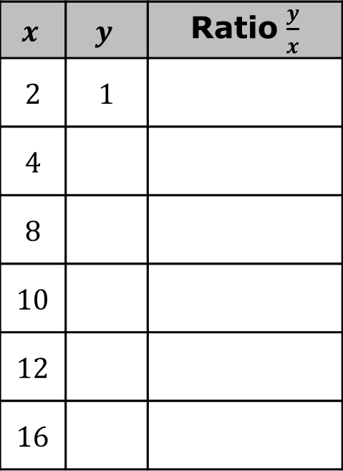

Use the graph to complete the table.
Use the table to complete the equation with the constant of proportionality.
$$y= ___ x$$
$$x$$ | $$y$$ | Ratio $\frac{y}{x}$
2 | 1
4
8
10
12
16
volume 1, pg. 256

Slide 14
The graph of the same relationship is shown with three right triangles such that their hypotenuses are on the line.
volume 1, pg. 256

Slide 15
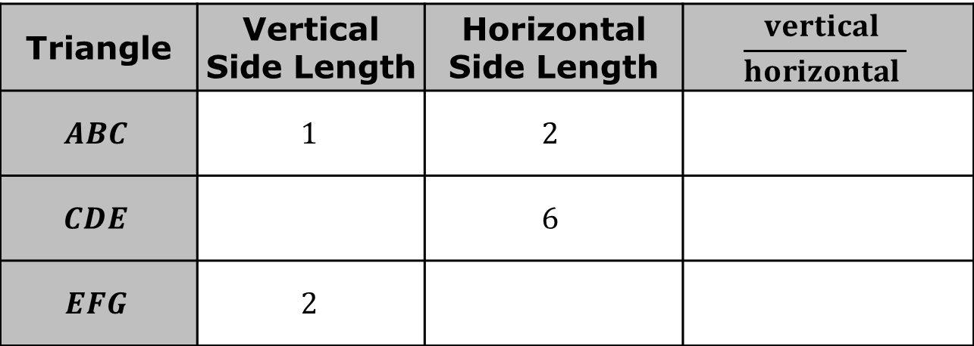
Complete the table for the ratio of the vertical side lengths to the horizontal side lengths of each right triangle.
Triangle | Vertical Side Length | Horizontal Side Length | $$\frac{vertical }{horizontal }$$
$$ABC$$ | $$1$$ | $$2$$
$$CDE$$ |  | $$6$$
$$EFG$$ | $$2$$
volume 1, pg. 256

Slide 16
What is the value of each ratio in simplest form?
What is the slope of the line?
Discuss with your partner how identifying the constant of proportionality is related to determining the slope of a proportional relationship. Summarize your discussion.
volume 1, pg. 257

Slide 17
The slope of any linear relationship can be determined using two points on the line.
volume 1, pg. 257

Slide 18
Discuss with your partner how the slope of any line could be determined when right triangles are not given on a graph. Then, summarize your discussion.
volume 1, pg. 257

Slide 19

Guided Instruction
volume 1, pg. 258

Slide 20
6.4.4 Guided Instruction: Finding Slope given Two Points
The graph of a line is shown with the coordinates of two of its points labeled.
Sketch a right triangle with a hypotenuse on the line and vertices connecting the two given points.
volume 1, pg. 258

Slide 21
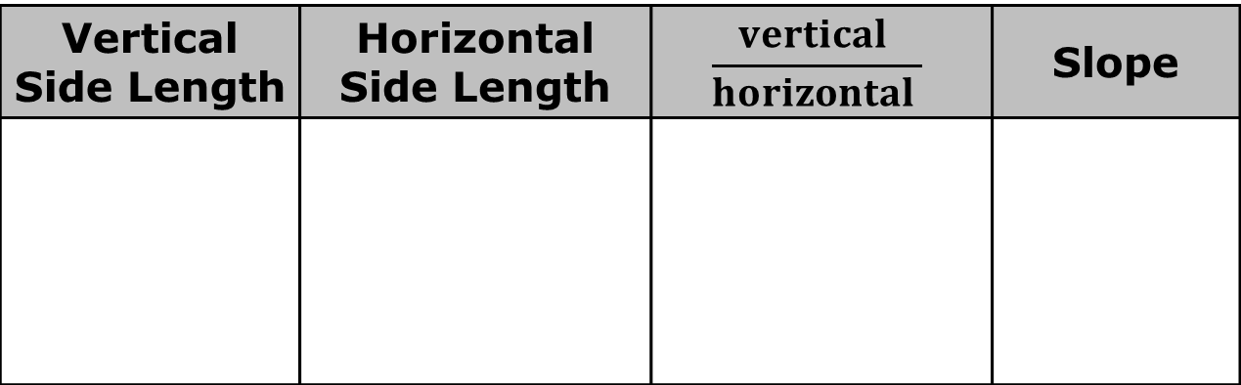
Compare your sketch to your partner’s sketch.
Use the right triangle to complete the table.
Vertical Side Length | Horizontal Side Length | $$\frac{vertical }{horizontal }$$ | Slope
volume 1, pg. 258

Slide 22
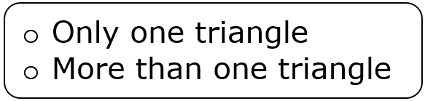
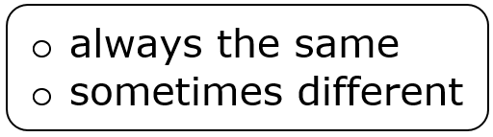
Complete the statement.
is needed to determine the slope
of the line because the slope is
between any two points on the same line.
volume 1, pg. 258

Slide 23
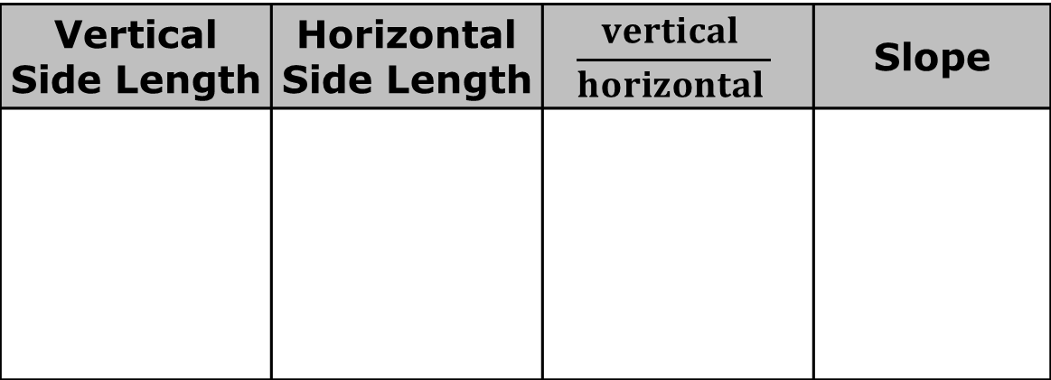
The graph of a line is shown.
Use the graph to complete the table.
Vertical Side Length | Horizontal Side Length | $$\frac{vertical }{horizontal }$$ | Slope
volume 1, pg. 258

Slide 24
Without counting the units on the graph, how can the vertical distance between two points be determined?
Without counting the units on the graph, how can the horizontal distance between two points be determined?
volume 1, pg. 259

Slide 25

Your Turn
volume 1, pg. 259

Slide 26
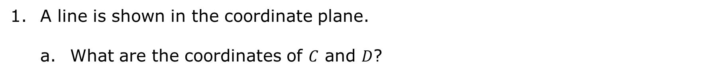
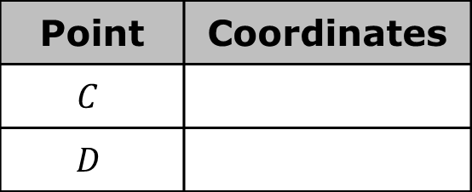
6.4.5 Your Turn!
A line is shown in the coordinate plane.
What are the coordinates of $C$ and $D$?
Point | Coordinates
$$C$$
$$D$$
volume 1, pg. 259

Slide 27
Determine the slope of the red line.
volume 1, pg. 259

Slide 28
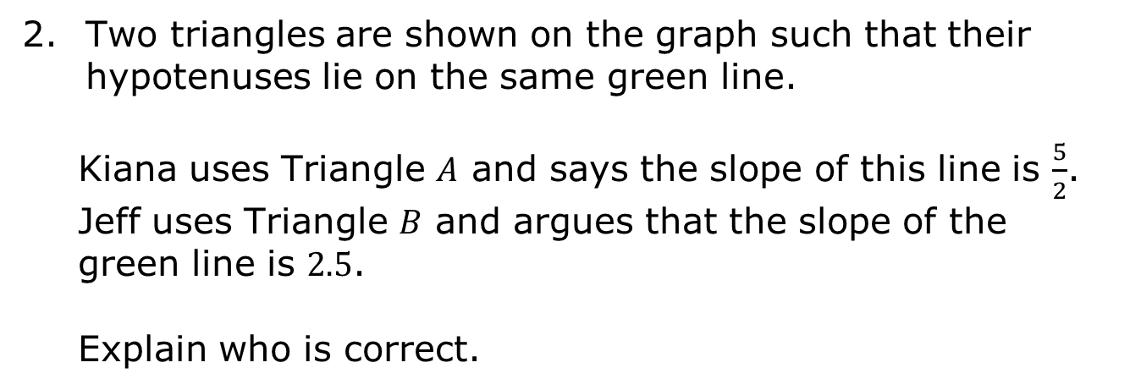
Two triangles are shown on the graph such that their hypotenuses lie on the same green line.
Kiana uses Triangle $A$ and says the slope of this line is $\frac{5}{2}$. Jeff uses Triangle $B$ and argues that the slope of the green line is $2.5$.
Explain who is correct.
volume 1, pg. 260

Slide 29

Wrap-Up
volume 1, pg. 260

Slide 30
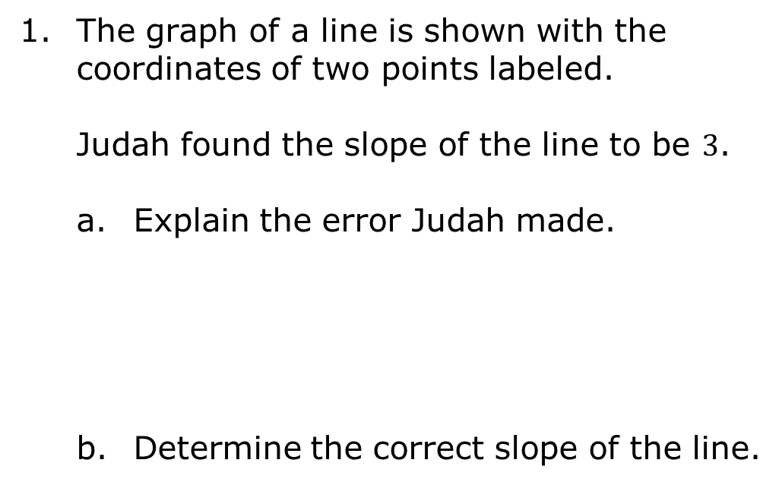
6.4.6 Wrap-Up: Error Analysis
The graph of a line is shown with the coordinates of two points labeled.
Judah found the slope of the line to be $3$.
Explain the error Judah made.
Determine the correct slope of the line.
volume 1, pg. 260

